Slide 1
Module - X: Advanced Prompt Engineering: Tree-of-Thoughts (ToT) Prompting, Active prompting, Reason and Act (ReAct), Expert Prompting, Automatic Prompt Engineering (APE).

Slide 2
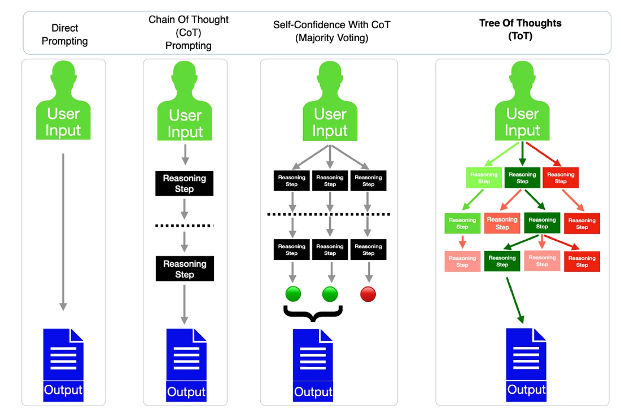
Advanced Prompt Engineering: Tree-of-Thoughts (ToT) Prompting

Slide 3
ToT
turning your AI from a straight-line thinker into a branching strategist. Instead of following one path (like a single chain of thought), it explores multiple reasoning paths simultaneously, compares them, and picks the best one.
What is Tree-of-Thoughts?
Tree-of-Thoughts is a prompting technique where the model:
Generates multiple possible reasoning steps (thoughts)
Organizes them like branches of a tree 🌿
Evaluates and prunes weaker paths
Continues expanding the most promising ones

Slide 4
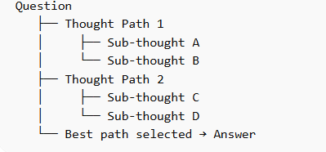
Examples
Chess players imagining multiple moves ahead ♟️ rather than just one.
Structure of ToT
Question → One reasoning path → Answer

Slide 5
Key Components
1. Thought Generation
Create multiple candidate steps
Example: different strategies to solve a problem
2. State Evaluation
Score or judge each path:
Logical correctness
Feasibility
Relevance
3. Search Strategy
Breadth-first: explore many options shallowly
Depth-first: go deep into one promising path
Beam search: keep top k best paths
4. Pruning
Drop weak or incorrect branches ❌
Focus computation on stronger paths ✅

Slide 6
Problem: "How to increase student engagement in online classes?"
ToT Reasoning:
Path 1: Gamification 🎮
Path 2: Interactive tools 💻
Path 3: Personalized learning 🎯
Each path expands:
Gamification → quizzes, leaderboards, rewards
Interactive → polls, breakout rooms
Personalized → adaptive content
Then evaluate:
Which is scalable?
Which fits budget?
Which improves outcomes?
👉 Final answer combines best elements.

Slide 7
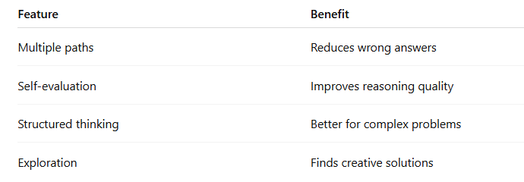
Why ToT is Powerful
Limitations
Method | Style
Standard Prompting | Direct answer
Chain-of-Thought | Single reasoning path
Tree-of-Thoughts | Multiple paths + evaluation

Slide 8
Simple ToT Prompt Template
Problem: [Your question]
Step 1: Generate 3 possible approaches.
Step 2: For each approach, break into steps.
Step 3: Evaluate each approach (pros/cons).
Step 4: Select the best approach.
Step 5: Provide final answer.

Slide 9
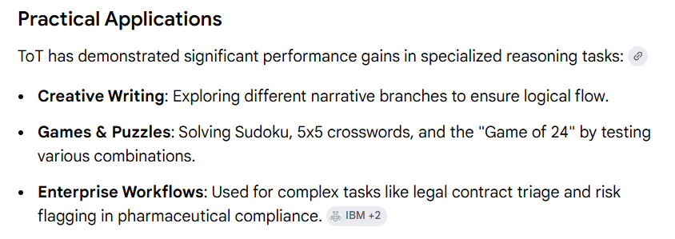
Applications
Complex decision-making
Research problems
Business strategy
Coding/debugging
Interview problem solving

Slide 10
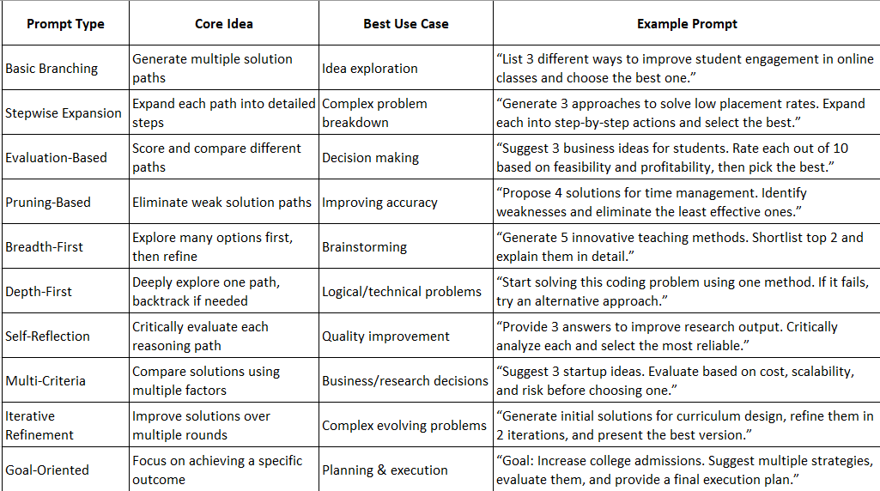

Slide 11
Active prompting
Active Prompting is a prompting technique where the AI actively evaluates, questions, and improves its own responses during the reasoning process.
Instead of giving a one-shot answer, the model:
Identifies uncertainty or possible errors
Revisits and verifies its steps
Refines the solution based on feedback or confidence.
Active Prompting makes the AI behave like a careful thinker who checks, corrects, and improves its own work before finalizing the answer.

Slide 12
Active Prompting – Process Flow
Think of it as a loop rather than a straight line:
Step 1: Initial Response
Model generates a first answer
Step 2: Uncertainty Detection
Identifies weak or doubtful parts
“Which step might be wrong?”
Step 3: Verification
Rechecks logic, calculations, assumptions
Step 4: Refinement
Corrects mistakes or improves clarity
Step 5: Final Answer
Outputs a more reliable, validated response

Slide 13
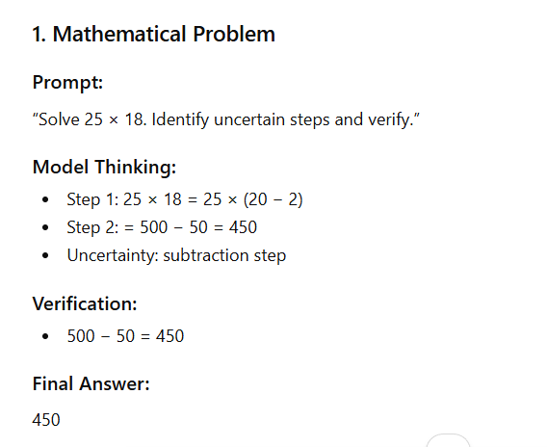
Examples of Active Prompting

Slide 14
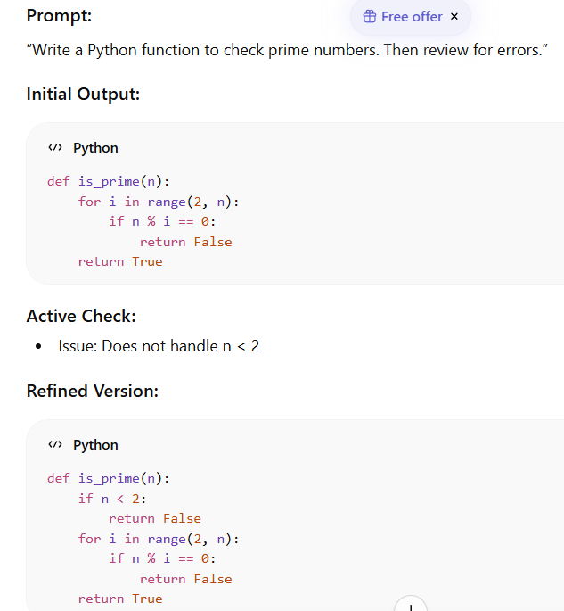

Slide 15
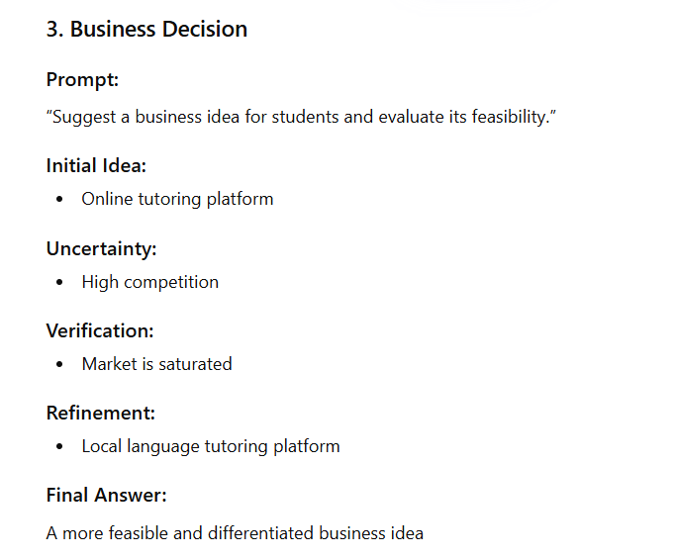

Slide 16
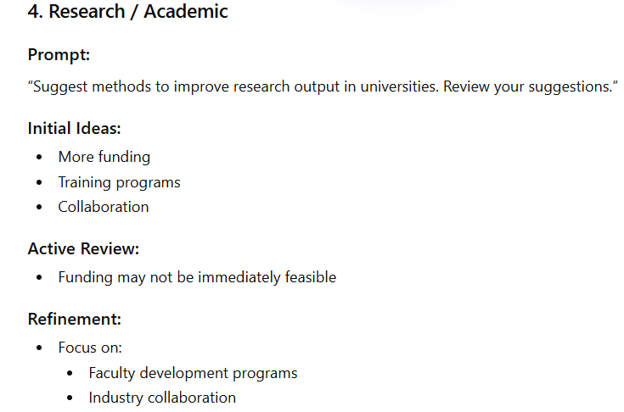

Slide 17
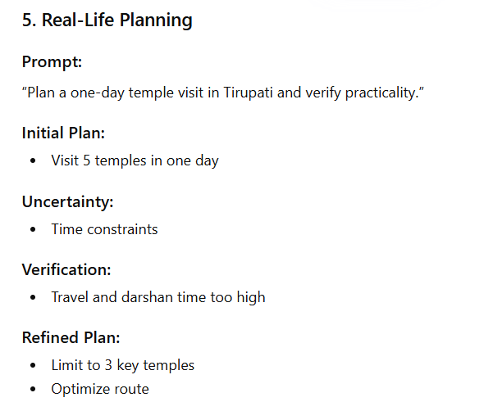

Slide 18
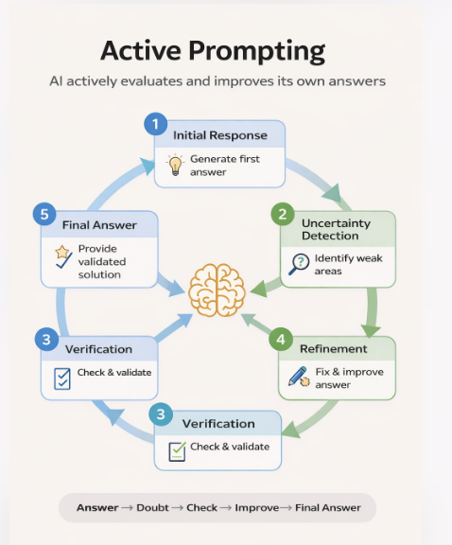

Slide 19
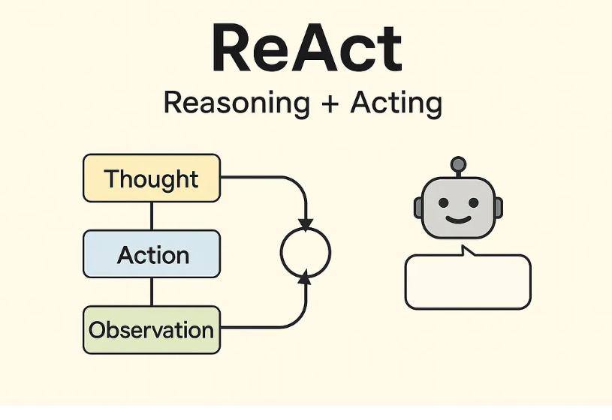
Reason and Act (ReAct)
ReAct (Reasoning + Acting) Prompting is a technique used to improve AI models in solving problems. It combines two important processes i.e reasoning (thinking through the problem) and acting (taking actions based on that thinking).
This technique helps AI to take more intelligent and adaptive decisions in dynamic environments like robotics, customer service and decision-making systems.

Slide 20
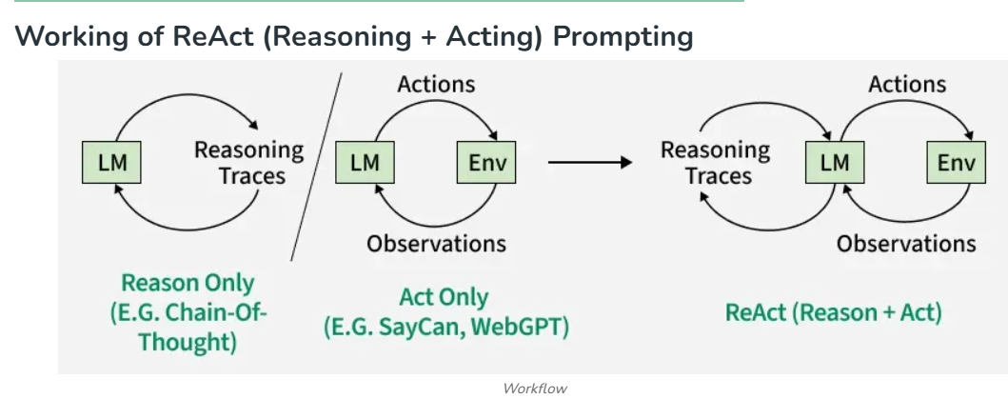

Slide 21
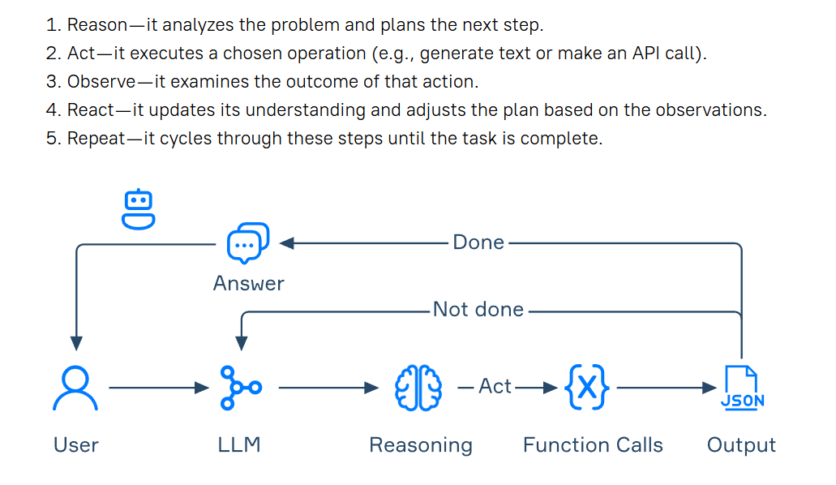

Slide 22
Example
Question: Who is the current President of India?
ReAct Process: Thought: I need up-to-date information Action: Search("President of India") Observation: Droupadi Murmu Thought: The answer is identified Final Answer: Droupadi Murmu

Slide 23
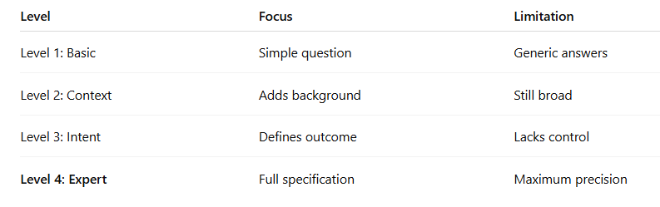
Expert Prompting
Expert Prompting sits right at the top like a seasoned captain steering the ship . Let’s decode your image in a crisp, structured way.
Expert Prompting = giving the AI a complete creative brief
You define tone, format, constraints, examples, and expectations so the AI responds like a trained professional.

Slide 24
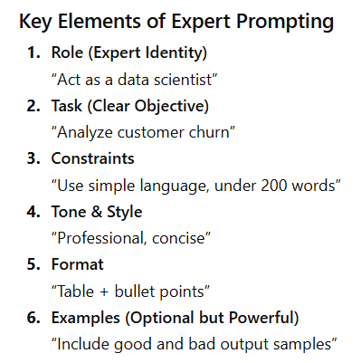
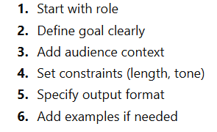
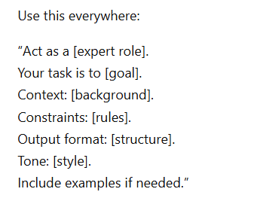

Slide 25
Automatic Prompt Engineering (APE)
Automatic Prompt Engineering (APE) is a technique where AI systems automatically create, evaluate, and optimize prompts to improve performance on a task.
Core Idea
Instead of asking: “Write a good prompt for summarization”
APE does this internally:
Generates multiple prompts.
Tests them on examples.
Scores outputs.
Selects the best-performing prompt.
It’s like running a mini competition where prompts fight for survival.

Slide 26
Work Process
Prompt Generation AI creates multiple candidate prompts
Execution Each prompt is used on sample inputs
Evaluation Outputs are scored (accuracy, relevance, quality)
Selection Best prompt is chosen
Iteration Process repeats to improve further
Input Task → Generate Prompts → Test → Score → Pick Best → Improve → Final Prompt

Slide 27
Task : Translate English to French
APE Generated Prompts
“Translate the sentence into French”
“Convert the following English text to formal French”
“Act as a professional translator and translate accurately”
APE tests all and selects the one giving best results consistently.

Slide 28
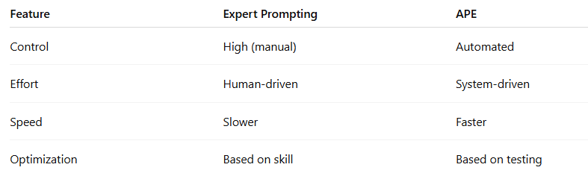
Why It Matters
Without APE:
Trial and error by humans
Time-consuming
Inconsistent quality
With APE:
Faster optimization
Better performance
Scalable across tasks

